Slide 1
DIGI Menu
A better food ordering experience

Slide 2
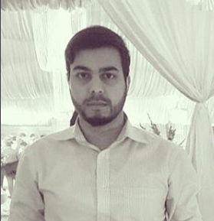
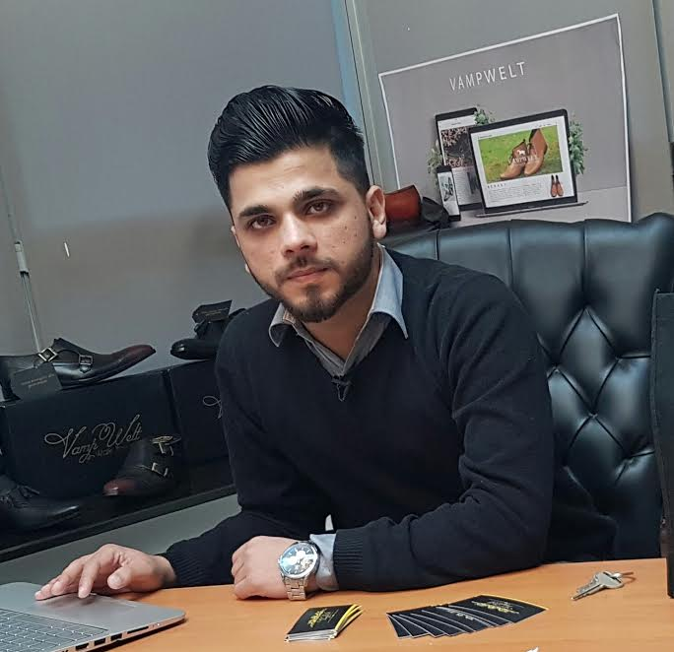
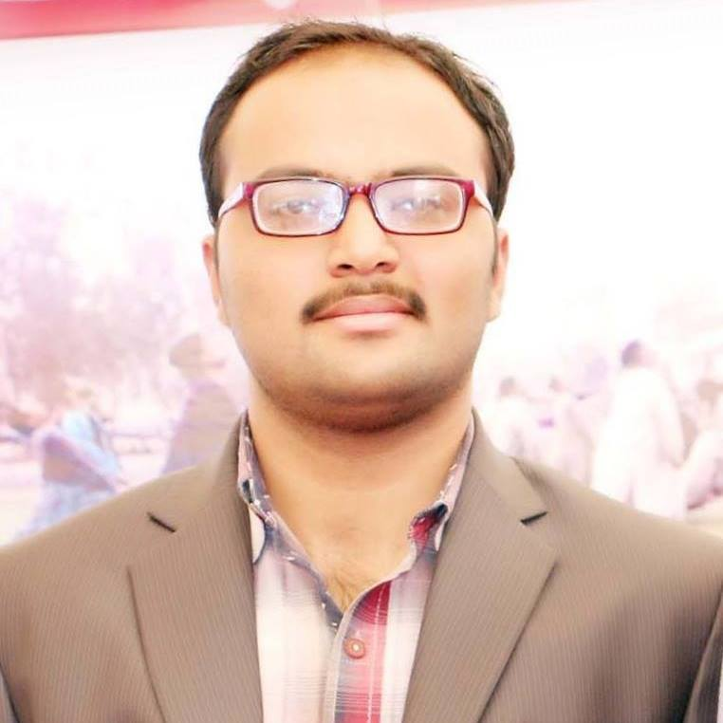
Team Members
M Ali Ahmed
Bscs13016
Ahmad nawaz
Bscs13046
Moazzam shoukat
Bscs13016

Slide 3
Problem
Bad food experiences
No price comparison
Not recommended deals
No reviews
No verdict

Slide 4
Value Proposition
Provide the digital menu
Food with pictures
And ordering system
Photo reviews

Slide 5
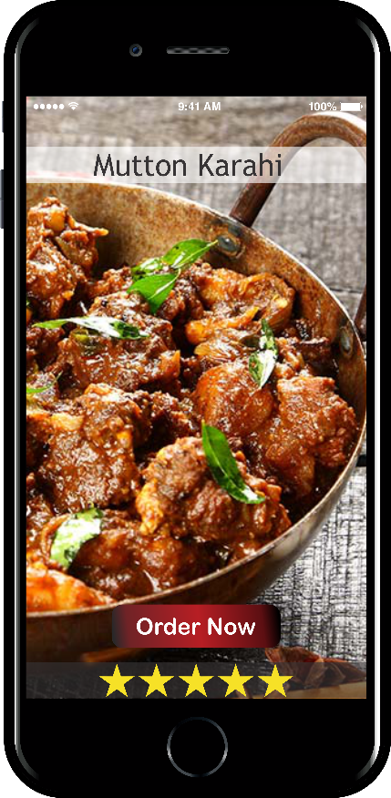
Solution
Application
Different Restaurants
Home Delivery
Picture review
(Real Pictures)
Prices
(Comparisons)
Verdict

Slide 6
Story Boarding
Go to Restaurant
Order Food
2
Looks at menu App
Check food Reviews
3
Order food
And get served

Slide 7
Task
Login/ Registration
See the deals on front page
Search deals
View
Order
Give Review

Slide 8
Video
https://youtu.be/2vK4YTPty0E

